Slide 1
Reversing an array in-place overview
The problem is that we want to reverse a T[] array in O(N) linear time complexity and we want the algorithm to be in-place as well - so the algorithm can not use additional memory!
For example: input is [1,2,3,4,5] then the output is [5,4,3,2,1]
Good luck!

Slide 2
Anagram problem overview
Your task is to construct an algorithm to check whether two words (or phrases) are anagrams or not!
"An anagram is a word or phrase formed by rearranging the letters of a different word or phrase, typically using all the original letters exactly once"
For example: restful and fluster are anagrams.
Good luck!

Slide 3
Palindrome problem overview
"A palindrome is a string that reads the same forward and backward"
For example: radar or madam
Your task is to design an optimal algorithm for checking whether a given string is palindrome or not!
Good luck!

Slide 4
Integer reversion problem overview
Your task is to design an efficient algorithm to reverse a given integer. For example if the input of the algorithm is 1234 then the output should be 4321.
NOTE: the input is an integer (and not a string) !!!
Good luck!

Slide 5
Dutch national flag problem overview
The problem is that we want to sort a T[] one-dimensional array of integers in O(N) running time - and without any extra memory. The array can contain values: 0, 1 and 2 (check out the theoretical section for further information).
Good luck!

Slide 6
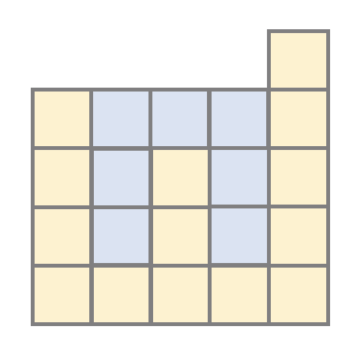
Trapping rain water problem overview
Given n non-negative integers representing an elevation
map where the width of each bar is 1. Compute how much water it can trap after raining!
Here the elevation map (the input for the algorithm) is [4,1,3,1,5] and the output is the total units of trapped rain water - which is 7.
Good luck!

